Slide 1
Walknet: A Deep Learning Approach to improving sidewalk quality and accessibility
Andrew Abbott, Alex Deshowitz, Dennis Murray
November 10, 2017

Slide 2

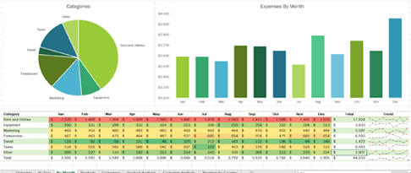
The Problem Today, municipalities rely on word of mouth or expensive contractors using excel spreadsheets to identify sidewalk and infrastructure improvement projects
Today, $ are allocated via:
This approach is neither efficient nor accurate
Also allows for the introduction of spending bias
The loudest voice in the room tends to get the infrastructure dollars, resulting in a high level of subjectivity
Or
Excel
Complaints

Slide 3
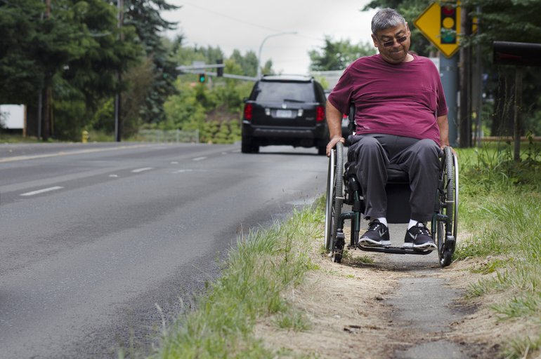
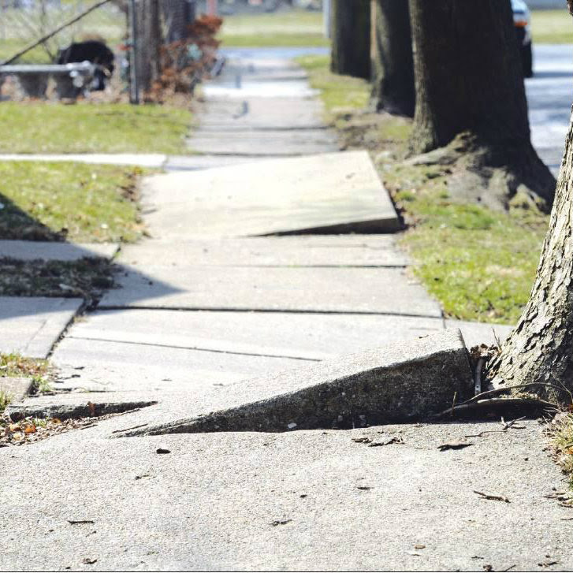
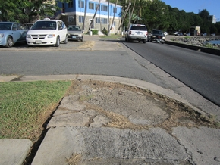
Why is this problem a big deal? It is estimated that every major metroplex in the United States has large areas which are either inaccessible to or provide challenges to the disabled
Sidewalks remain the single most used means of transportation for those who are mobility challenged
Only 17.4% of working-age wheelchair users are employed
This means that many of those bound to wheelchairs do not have the ability to purchase other modes of transportation and rely heavily on sidewalks
In many cases, sidewalks are their only path to get where they need to go
For many municipalities the process of sidewalk assessment is a painstaking process that involves subjective assessment

Slide 4

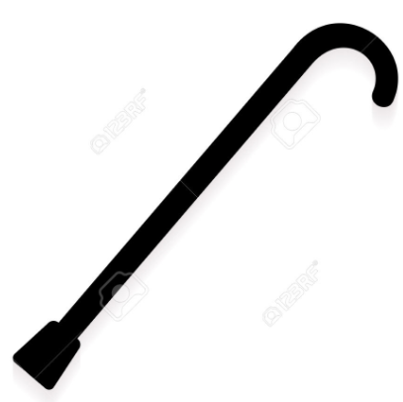
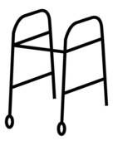
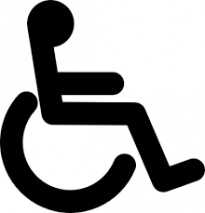

This problem isn’t going away Each year, approximately 2 million new users adopt wheelchairs as their primary mode of mobility and ambulatory disabilities are the largest portion of total disabilities
As baby boomers continue to age the rate of increase in the population of wheel chair users will continue to rise
Ambulatory disabilities continue to be both the fastest growing and the largest portion of total disabilities in the country
6.7% of the U.S. population
+ 2 Million people each year

Slide 5
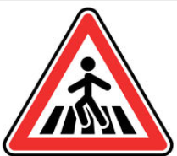

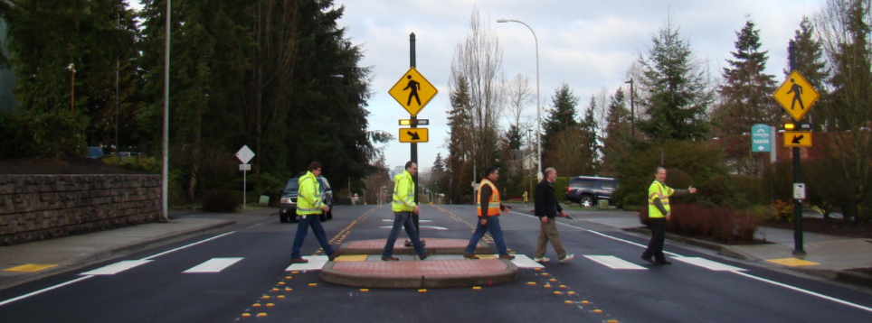
…And it doesn’t just impact the mobility impaired In 2015, 5,376 pedestrians and 818 bicyclists were killed in crashes with motor vehicles, representing approximately 18% of the total traffic fatalities in that year
While total traffic fatalities have been on the decline for several years, pedestrian fatalities increased by 12 percent between 2006 and 2015 and continue to rise
The number of pedestrians killed in 2015 was the highest this statistic has been since 1996
An estimated 70,000 pedestrians were also injured in vehicle wrecks in 2015
Providing better curb cut designations and crosswalks in the correct places with better visibility could have potentially mitigated these deaths
5,376 pedestrians
818 bicyclists
Better sidewalks = lives saved

Slide 6


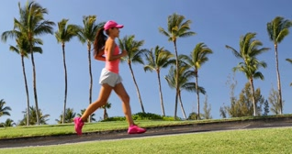
…poor sidewalk quality also carries health ramifications The CDC states that inaccessible or nonexistent sidewalks have been linked the sedentary habits that are growing at an alarming rate in the U.S.
The sedentary habits and lifestyles of Americans is nothing short of an epidemic
A lack of physical activity leads to diseases such as obesity, cardiovascular disease, diabetes, and even cancer
If the small price of building sidewalks has the ability to offset skyrocketing medical costs and death, shouldn’t we as a society invest in ourselves?
9.4% of the population
1.5M new cases/year
#1 killer of Americans: heart disease
Better sidewalks = healthy living

Slide 7

This begs the question: why we aren’t doing more today? If there are so many ramifications to having poor sidewalk and curb cut infrastructure, why aren’t we doing more?
If poor sidewalks =
Inaccessibility
Hazards
Health risk
What are we doing to solve the problem?

Slide 8
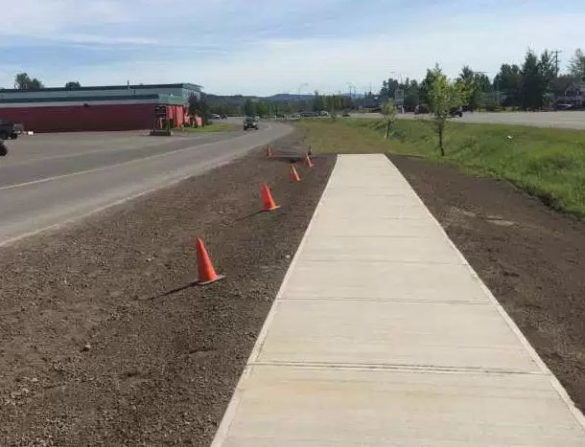
We tried: American recovery and Reinvestment Act In 2009, this $831B program that carved out over $100B for infrastructure improvement, but many dubbed the outcome as the “sidewalk to nowhere”
The program’s heart was in the right place, but implementation was poor

Slide 9
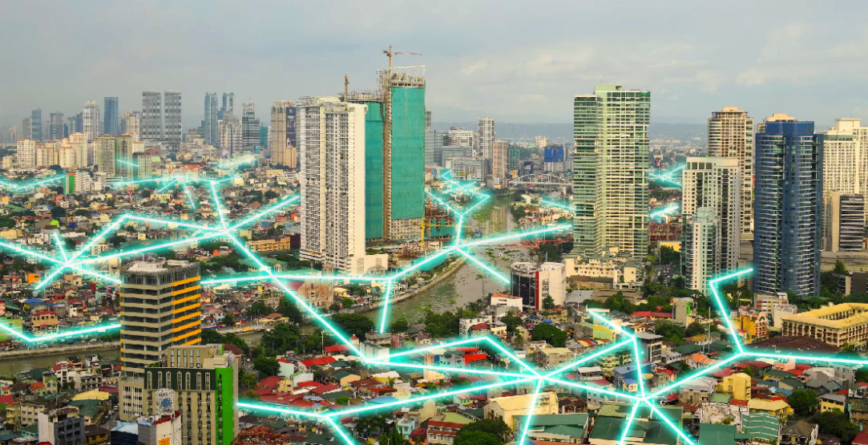
Introducing WalkNet A tool that allows municipalities to identify areas in need, score their infrastructure, and identify opportunities for investment
Accurate identification of lack of safe crosswalks
Hazard identification
Infrastructure scoring
Expenditure optimization

Slide 10

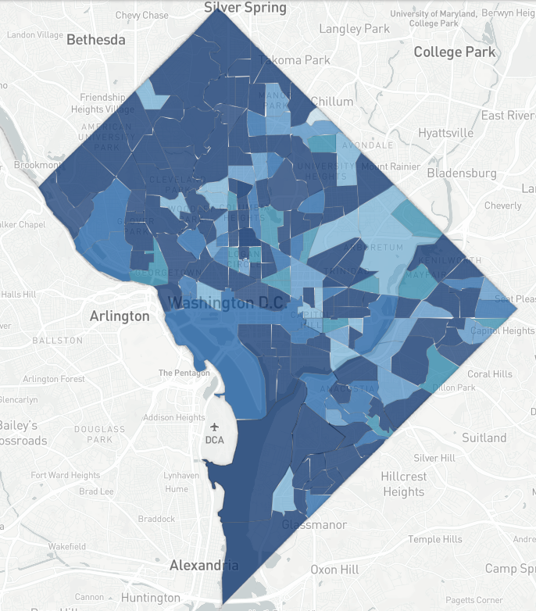
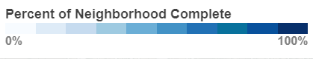
How it works: partnering with Project Sidewalk Project sidewalk uses crowd sourced hazard identification from the public to collect data on D.C. area sidewalks
To date has used crowd-sourcing to map over 87% of D.C.
940 Miles mapped
132,134 labels created
Users are presented with Google StreetView images and are asked to label any hazards
The University of Maryland team shared over 40 gb of image files with the Walknet team
Our data contained bounding box information for curb cuts

Slide 11
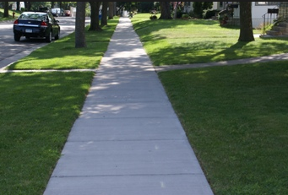
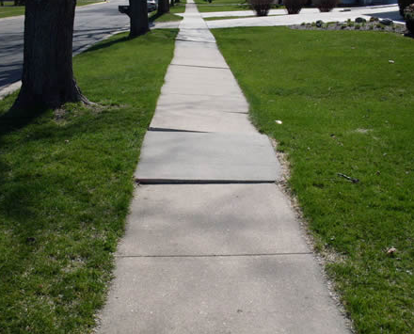
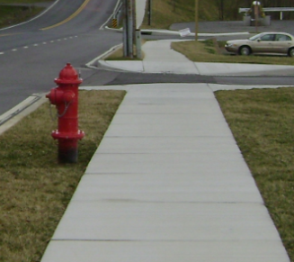
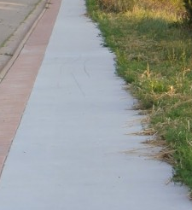
How it works: Why use D.C. data? The project sidewalk data provided a perfect resource, because it contained data that had been pre-labeled for training and prevented the team from hand labeling images
Sidewalks tend to have the same features regardless of geolocation
In general, sidewalks, curb cuts, and obstacles are similar regardless of geolocation
Allowed for quick training of models
Did not require a great deal of ancillary research and labeling by-hand

Slide 12
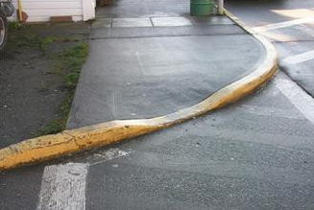
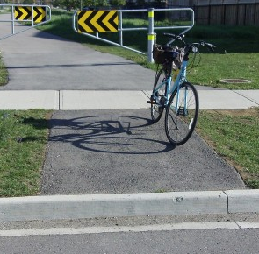
How it works: curb cuts (1 of 2) The data provided by the UMD team contained huge image files and a series of coordinates for each feature identification; we had to cut those curbs from the images
Using bounding box coordinates, the curbs were cut from the larger images
This reduced the size of the images
Bounding boxes allow for the unique features to be fed into algorithm
Bounding boxes isolate features

Slide 13
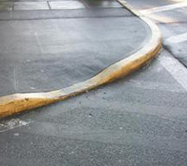
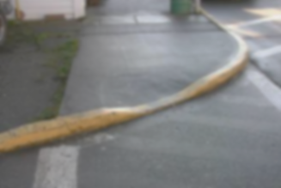
How it works: curb cuts (2 of 2) Once the curb cuts were isolated, these images had to be resized to 100 x 100 x 3 so that the features would still be recognizable and ingestible to the model
Resizing was necessary to lower the overall size of the data being used by the algorithm
Additionally, all images now had the same number of features
100 X 100 X 3 = 30,000 pixels
Normalized to 255
= 100 * 100 * R * G * B = 30,000 features/image

Slide 14
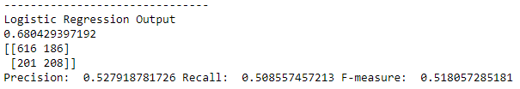
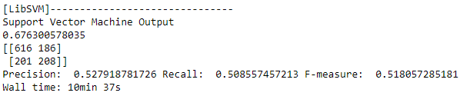
How it works: The naïve model To get a naïve baseline estimate of the model accuracy at identifying curb cuts, logistic regressions and support vector machines were created
Both the logistic regression and the SVM output the same results
These models didn’t really learn the data
Something more robust was needed

Slide 15
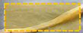
How it works: CNN (1 of 2) To better replicate visual identification, a convolutional neural network was deployed; these models consist of layers that deconstruct images, much like the visual cortex
How a Convolutional Neural Network (CNN) works
1.) input image
2.) extract region proposals
3.) Compute CNN features
4.) Classify
Warped region
Curb cut
No-Curb cut

Slide 16
How it works: CNN (2 of 2) The resulting model was able to identify the cases where curb cuts did not exist with a high degree of accuracy in just 8 convolutional layers
Results on 8-layer Convolutional Neural Network (CNN)
Created using Keras API – TensorFlow backend
 | Loss | Accuracy
Epoch 1/10 | 0.6140 | 70.10%
Epoch 2/10 | 0.4775 | 76.52%
Epoch 3/10 | 0.4449 | 77.73%
Epoch 4/10 | 0.4065 | 80.17%
Epoch 5/10 | 0.3768 | 82.79%
Epoch 6/10 | 0.3303 | 85.60%
Epoch 7/10 | 0.2796 | 87.56%
Epoch 8/10 | 0.2289 | 89.94%
Epoch 9/10 | 0.1845 | 92.40%
Epoch 10/10 | 0.1467 | 94.32%

Slide 17
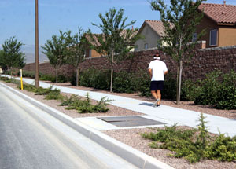
How do we implement the model? Now that we had a well-trained model, we needed a way to identify areas of interest in images; therefore, we used Google’s inception object detection API
Using pre-trained inception models, we can accurately extract just the sidewalk elements of Street View images
Pole~ 99%
Feed these into model trained to find “poor cuts”
Person~ 95%
Curb cut
No-Curb cut
Sidewalk~ 93%

Slide 18
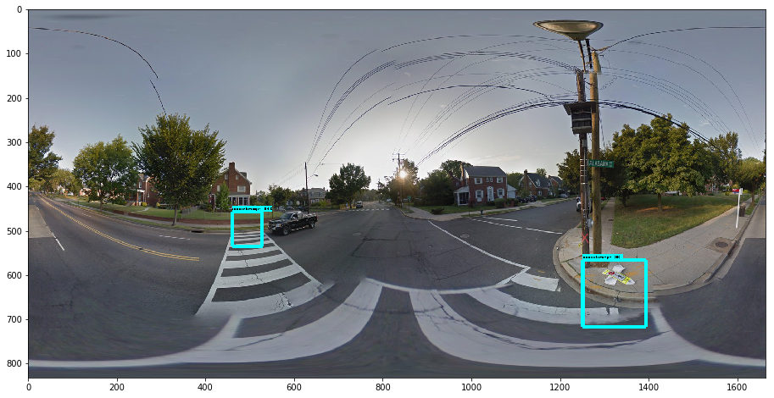
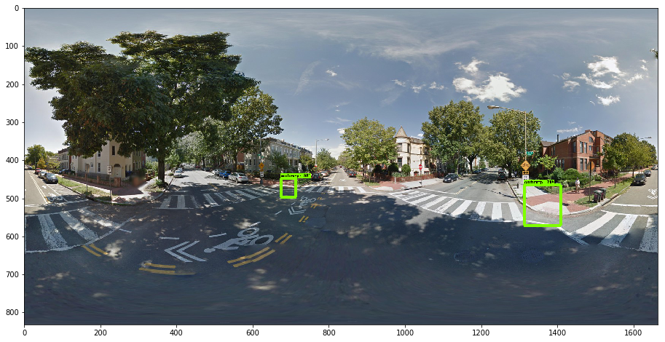
Model output on panoramic images The examples below show actual cuts that the model created on test sets of panoramic images; notice how depth and angle are accurately accounted for…
The bounding boxes below were drawn by the model. The model cuts these images and classifies them with the CNN

Slide 19
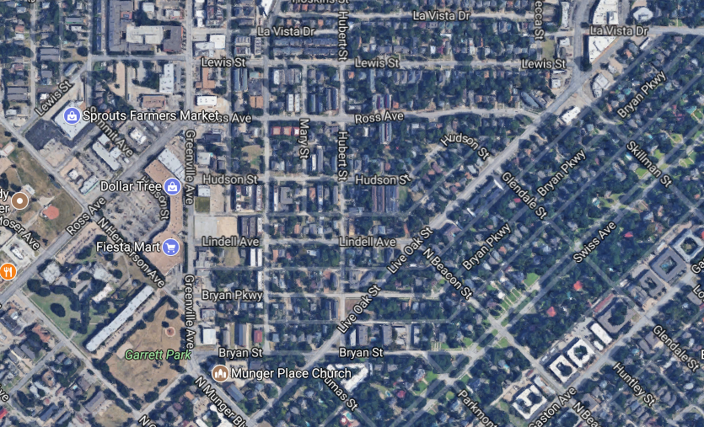
Now What? (1 of 2) Now that any image can be fed into the model, municipalities are able to leverage the classification process to identify areas that need improvement or budget allocation
Cities can use this model to create bird’s eye views of neighborhoods to identify the areas in most need

Slide 20
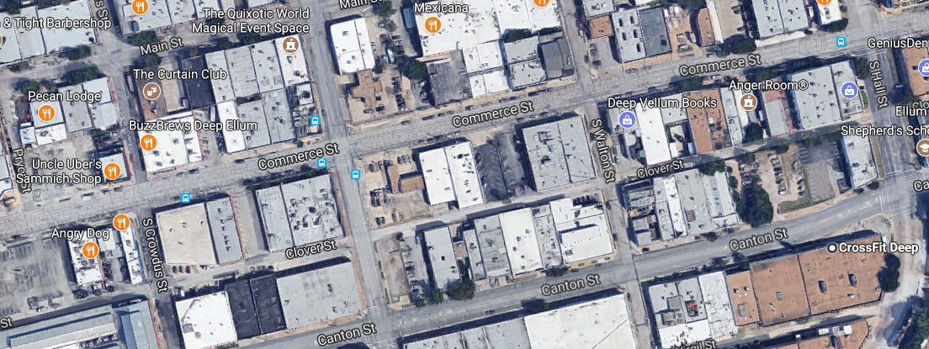


Now What? (2 of 2) This model could also be leveraged into an application for the mobility challenged that routes them on paths that contain quality infrastructure
Poor curb cut

Slide 21
Conclusion
This model demonstrates how Deep learning can be applied to an everyday problem such as poor sidewalk quality
Using tools such as Google’s object detection API, we can productionize the model in relatively short order
These models can now be used to create apps that aid in:
Planning infrastructure projects
Helping the disabled safely navigate a city
Expanding the mode beyond curbs to incorporate other obstacles

